Slide 1
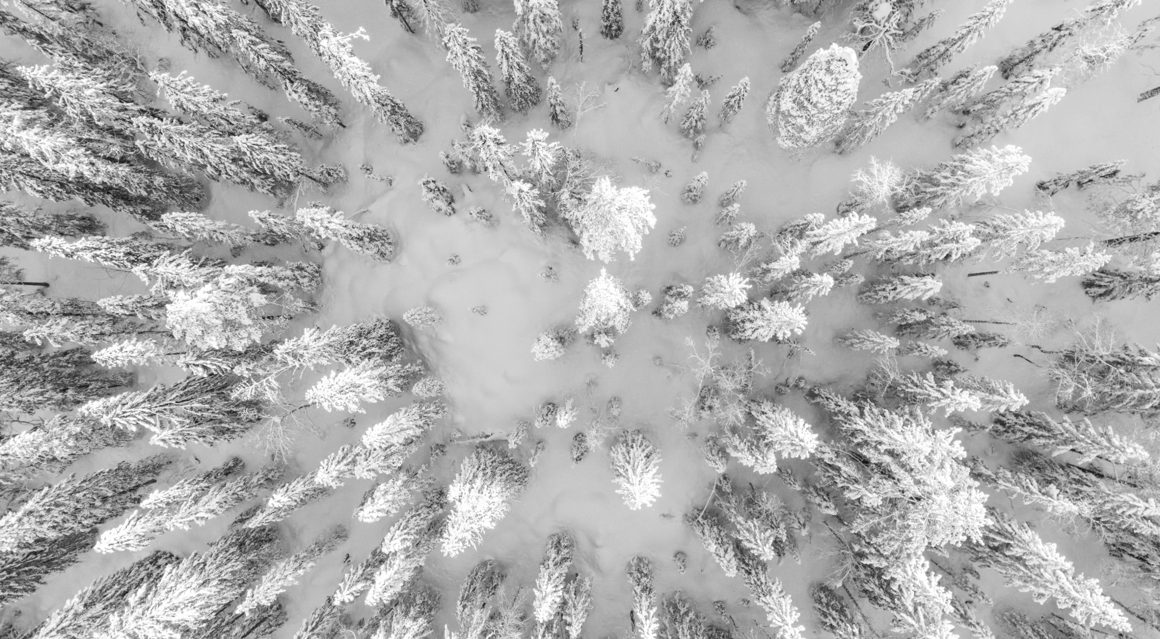
Big Mountain Resort
Models for increased revenue and decreased expenses

Slide 2
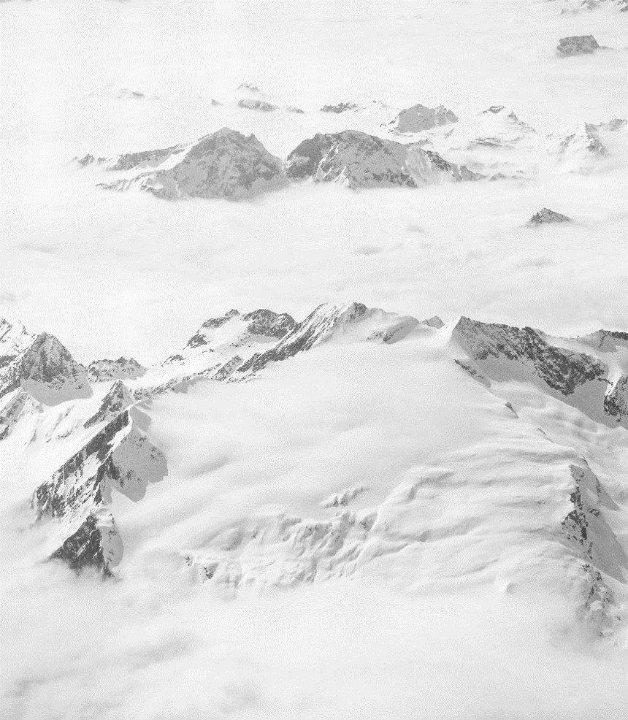
Problem Identification
Operating costs increased by $1.54m this season.
Need options to cut costs without cutting value
Need options to justify price increase
Looking Forward
Identify growth opportunities for future projects
Create modeling tool for Big Mountain to do their own analysis in the future

Slide 3
Recommendations and Key Findings
Cut least used runs and increase vertical drop by 15’.
Top 15% nationwide for top rated ski resort features
Cut up to 5 runs and still be in top 10% nationwide
Highest ticket price in Montana but low nationwide
Vertical drop one of the biggest drivers of price

Slide 4
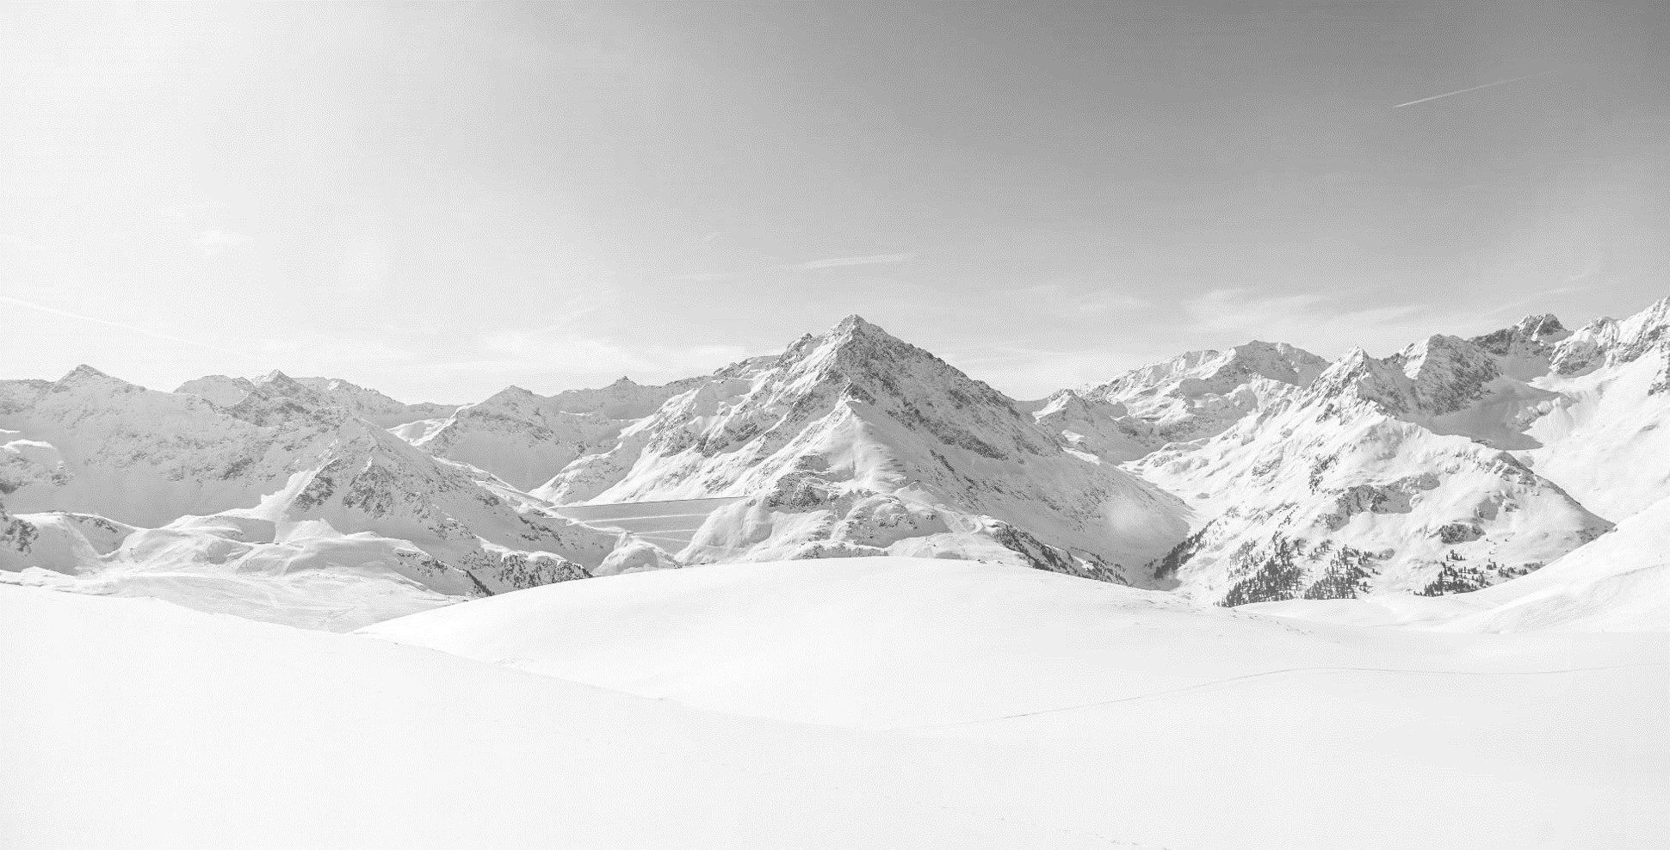
Modeling Results and Analysis

Slide 5
Modeling Results
Recommendations
Analysis Methods
Enhance key resort features for a projected .
Up to $3.47m increased revenue this season
Cut up to 5 of least used runs
Up to $1.3m decreased revenue this season
Need additional data to know operational cost reduction
Removed features with incomplete information from analysis
Identified features most highly correlated to price increases
Identified features most highly rated in similar markets
Evaluated current Big Mountain features on a national scale
Build a Linear and Random Forest Regressor Model to predict effects on ticket price based on changes to key features, Random Forest Model provided lower error

Slide 6
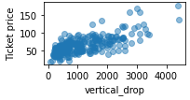
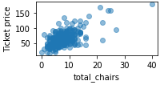
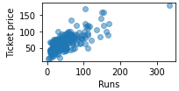
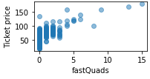
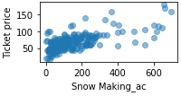
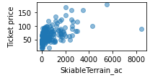
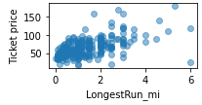
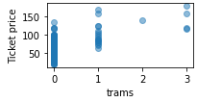
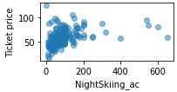
Largest contributing features to ticket price
Night Skiing didn’t correlate as highly nationwide, but did among states further north with longer nights.

Slide 7
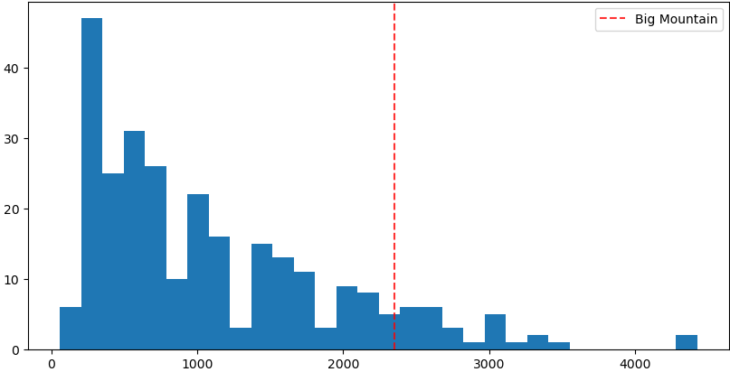
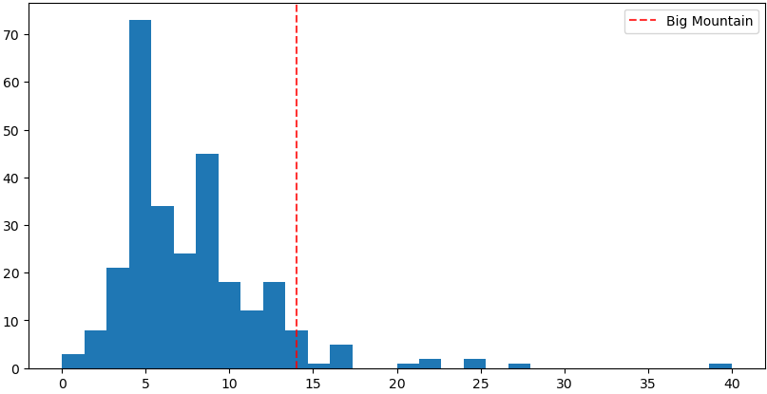
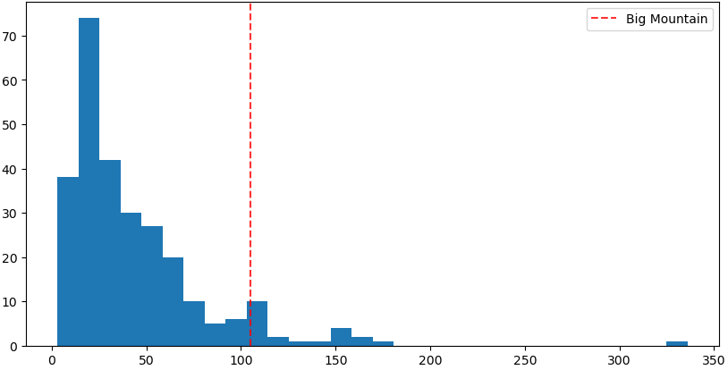
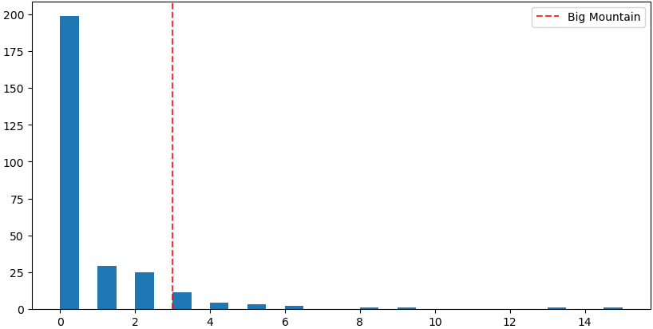
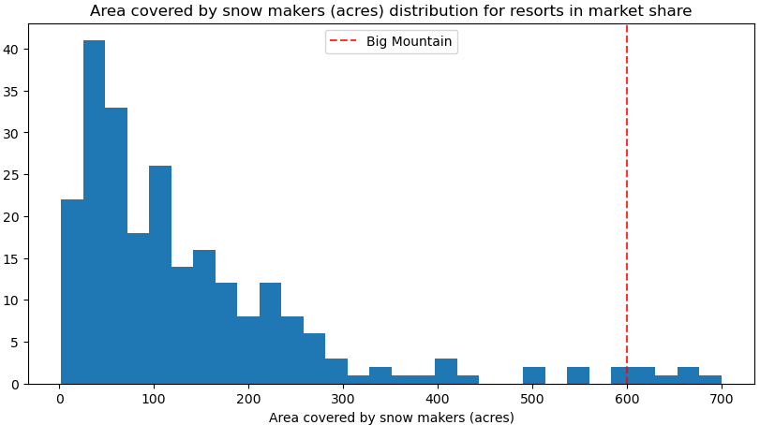
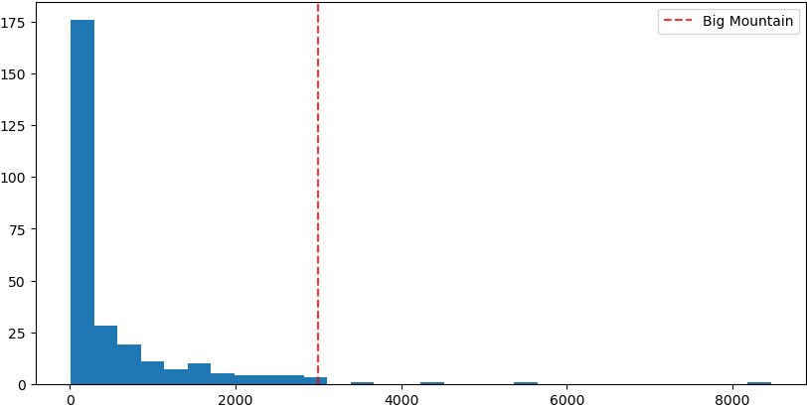
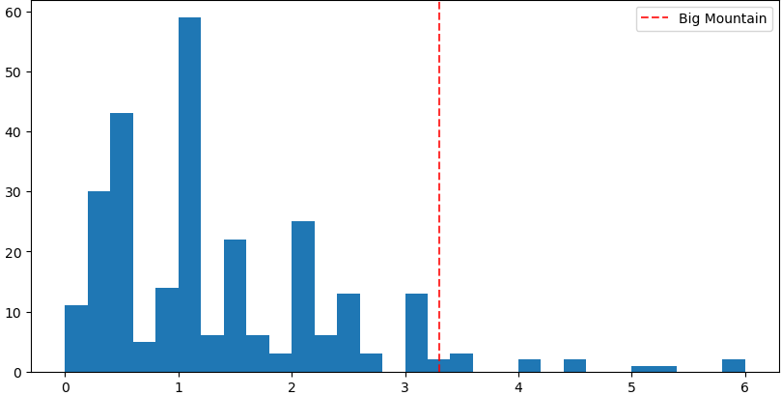
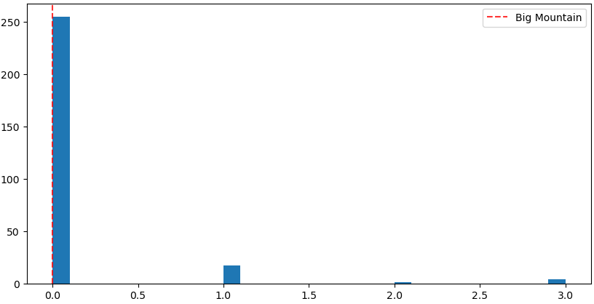
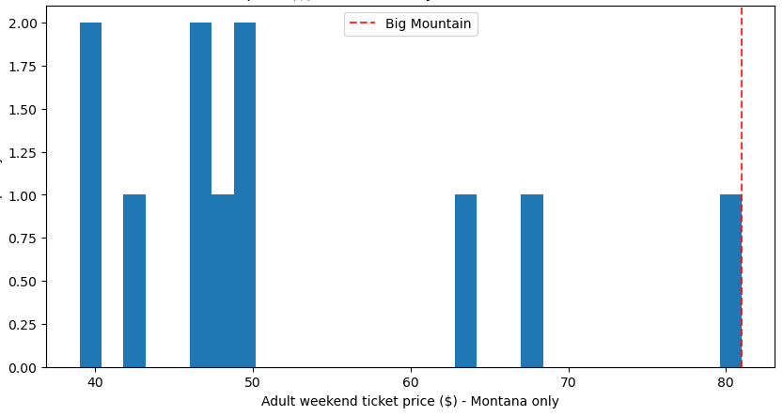
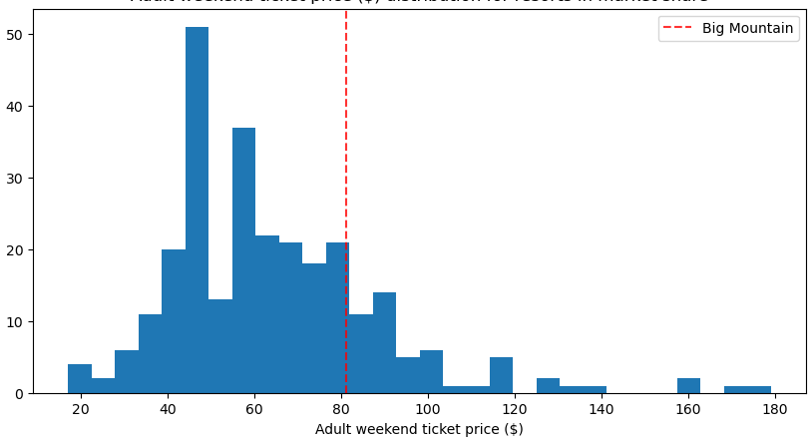
Big Mountain’s performance nationwide
Vertical Drop
Chairs
Runs
Fast Quads
Covered by
Snowmakers
Skiable Terrain
Longest Run
Trams
Ticket Price
Montana
Ticket Price
Nationwide
Top price in Montana
Room to grow by ~$10 and stay competitive nationwide

Slide 8
Recommendations based on modeling
Add a run, add a chair lift, add 15’ to vertical drop
Justify ~$3.47m in increased revenue
Drop 1 run for no drop in ticket price
Sweet spot is up to 5 runs closed
Stay in top 10% nationwide

Slide 9
Summary and Conclusion
Big Mountain is undervaluing itself within the nationwide market.
Adding a few key features could justify a significant increase in revenue that would be sustained over multiple seasons for a one-time capital expenditure.
Some of the least profitable features can be downsized to reduce operating costs.

Slide 10

Large Image Slide
miranda.barton@idscompany.com
Imaginary Data Science Company LLC

